Slide 1


Island Bay (Derwent Street)
House vibrations
GWRC (Metlink) and WCC present on the Derwent Street house vibration concerns
WCC & GWRC

Slide 2
Background
Why are we here?
What are the options?
We are here to hear your views…

Slide 3
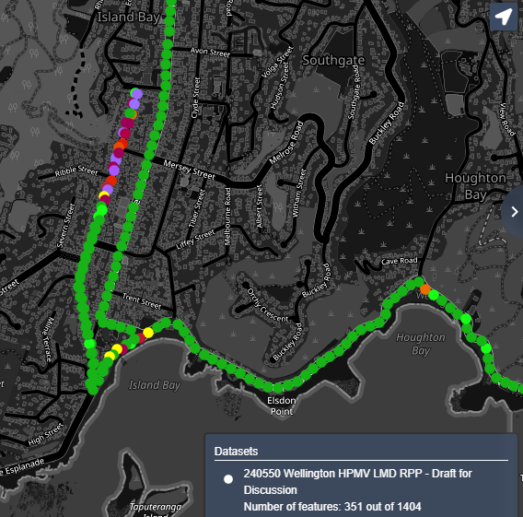
Laser Measure Deflectometer Survey (LMD)
This image shows the results of the LMD. This is a pavement structural survey that gives full definition of the deflection bowl, similar to Falling Weight Deflectometer (FWD).
The results shown here are pavement remaining life in years.

Slide 4
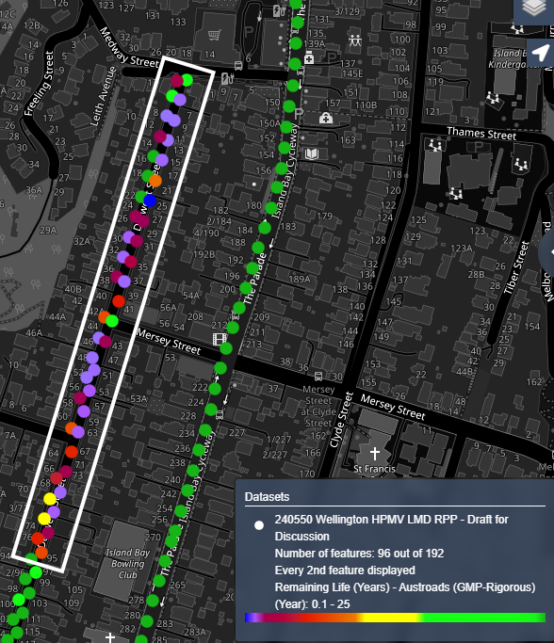
Derwent St LMD
The pavement in this section of Derwent St. from Medway St to No. 95 Derwent St is compromised, needing rehabilitation.
The rehabilitation cost of this section has been calculated at 60% of our annual road rebuild budget and would cause significant disruption to rebuild

Slide 5
Island Bay Bus Route Options

Slide 6
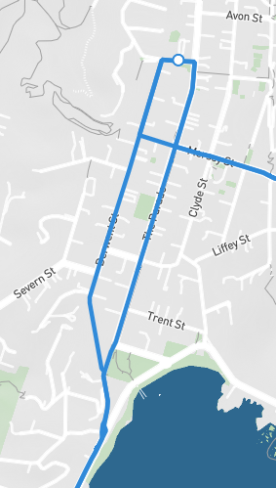
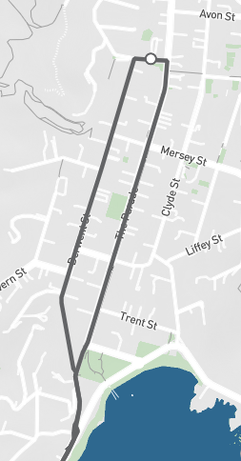
Current bus routes
Route 29
Route 39
48 services each weekday
33 Sat
26 Sun
4 services each weekday
24 services each weekday
16 Sat
13 Sun

Slide 7
Customers affected
Medway Street bus stop #6960
  Average of 1250 boardings and alighting's per month (2024). Average of 41 people per day
  Provides only local access to Island Bay Shops for 3162 residents of Owhiro Bay and Southgate.
  Route 29. Highest patronage is between 11am 4pm. High Gold Card usage.
  This bus stop is rarely used by morning commuters into the CBD.
  High usage for peak commuters in the evening.
  Route 39 service terminates at this stop.
  Approx. 2 people a day alight a service at this bus stop

Slide 8
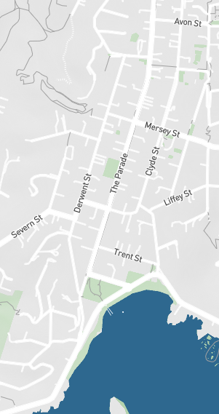
Options for Route 29
Current route
Remove south of Mersey
Complete removal
Island Bay
Shops
Island Bay
Shops
Island Bay
Shops
48 services each weekday
(17 Sat & 13 Sun)
Note: Alternative bus stops 6min walk from New World (400m)
24 services each weekday
(16 Sat & 13 Sun)
Low customer impact
High customer impact

Slide 9
Options
Low customer impact
Route 39
Current route
Route 39
Truncate to Reef Street
4 services each weekday which the bus runs empty.

Slide 10
Ngā mihi
  Thank you

